Slide 1

Working with Abstraction
Architecture, Refactoring and Enumerations
SoftUni Team
Technical Trainers
Software University
http://softuni.bg

Slide 2
Table of Contents
Project Architecture
Methods
Classes
Projects
Code Refactoring
Enumerations
Static Classes
Namespaces

Slide 3
Questions
sli.do #csharp-advanced

Slide 4

Project Architecture
Splitting Code into Logical Parts

Slide 5
Splitting Code into Methods
We use methods to split code into functional blocks
Improves code readability
Allows easier debugging
Allows us to easily reuse code
position[0] = row – 1
position[0] = row + 1
position[0] = row + 3
ChangeRow(desiredRow)

Slide 6
Example: Code without Methods
foreach (char move in moves)
{
for (int r = 0; r < room.Length; r++)
for (int c = 0; c < room[r].Length; c++)
if (room[row][col] == 'b')
…
}

Slide 7
Example: Code with Methods
foreach (char m in moves)
{
MoveEnemies();
KillerCheck();
MovePlayer(move);
}

Slide 8
Splitting Code into Methods (2)
We change a method once and the change affects all calls
var bankAcc = new BankAccount();
bankAcc.Id = 1;
bankAcc.Deposit(20);
bankAcc.Withdraw(10);
…
Console.WriteLine($"Account {bankAcc.Id}, balance {bankAcc.Balance}");
Override .ToString() to set a global printing format
Console.WriteLine(bankAcc.ToString());

Slide 9

Splitting Code into Methods (3)
A single method should complete a single task
void DoMagic ( … )
void DepositOrWithdraw ( … )
decimal DepositAndGetBalance ( … )
void Withdraw ( … )
void Deposit ( … )
decimal GetBalance ( … )

Slide 10
Problem: Rhombus of Stars
Draw on the console a rhombus of stars with size n
n = 3
n = 2
n = 1
*
* *
* * *
* *
*
*
* *
*
*
Check your solution here: https://judge.softuni.bg/Contests/1495/Working-with-Abstraction-Lab

Slide 11
Solution: Rhombus of Stars
int size = int.Parse(Console.ReadLine());
for (int stCount = 1; stCount <= size; stCount++)
PrintRow(size, stCount);
for (int stCount = size - 1; stCount >= 1; stCount--)
PrintRow(size, stCount);
Reusing code
Check your solution here: https://judge.softuni.bg/Contests/1495/Working-with-Abstraction-Lab

Slide 12
Solution: Rhombus of Stars(2)
static void PrintRow(int figureSize, int starCount)
{
for (int i = 0; i < figureSize - starCount; i++)
Console.Write(" ");
for (int col = 1; col < starCount; col++)
Console.Write("* ");
Console.WriteLine("*");
}
Check your solution here: https://judge.softuni.bg/Contests/1495/Working-with-Abstraction-Lab

Slide 13
Splitting Code into Classes
Just like methods, classes should not know or do too much
GodMode master = new GodMode();
int[] numbers = master.ParseAny(args);
...
int[] numbers2 = master.CopyAny(numbers);
master.PrintToConsole(master.GetDate());
master.PrintToConsole(numbers);

Slide 14
Splitting Code into Classes (2)
We can also break our code up logically into classes
ArrayParser parser = new ArrayParser();
OuputWriter printer = new OuputWriter();
int[] numbers = parser.IntegersParse(args);
int[] coordinates = parser.IntegerParse(args1);
printer.PrintToConsole(numbers);
Hides implementation
Allows us to change output destination
Helps us avoid repeating code

Slide 15
Problem: Point in Rectangle
Create a Point class holding the horizontal and vertical coordinates
Create a Rectangle class
Holds two points
Top left and bottom right
Add Contains method
Takes a Point as an argument
Rturns it if it’s inside the current object of the Rectangle class
Check your solution here: https://judge.softuni.bg/Contests/1495/Working-with-Abstraction-Lab

Slide 16
Solution: Point in Rectangle
public class Rectangle
{
private Point topLeft;
private Point bottomRight;
//TODO: Public properties
public bool Contains(Point point)
//TODO: Implement the method
}
Check your solution here: https://judge.softuni.bg/Contests/1495/Working-with-Abstraction-Lab

Slide 17
Solution: Point in Rectangle (2)
public class Point
{
private int x;
private int y;
//TODO: Add Public properties
}

Slide 18
Solution: Point in Rectangle (3)
public bool Contains(Point point)
{
bool isInHorizontal = this.TopLeft.X <= point.X && this.BottomRight.X >= point.X;
bool isInVertical = this.TopLeft.Y <= point.Y && this.BottomRight.Y >= point.Y;
bool isInRectangle = isInHorizontal && isInVertical
return isInRectangle;
}
Check your solution here: https://judge.softuni.bg/Contests/1495/Working-with-Abstraction-Lab

Slide 19

Refactoring
Restructuring and Organizing Code

Slide 20
Refactoring
Restructures code without changing the behaviour
Improves code readability
Reduces complexity
class ProblemSolver { public static void DoMagic() { … } }
class CommandParser
{ public static Func<T, T> ParseCommand(); }
class DataModifier
{ public static T Execute(); … }
class OutputFormatter
{ public static void Print(); … }

Slide 21
Refactoring Techniques
Breaking code into reusable units
Extracting parts of methods and classes into new ones
Deposit()
Withdraw()
DepositOrWithdraw()
Improving names of variables, methods, classes, etc.
string str;
string name;
Moving methods or fields to more appropriate classes
Car.Open()
Door.Open()

Slide 22
Problem: Student System
You are given a working Student System project to refactor
Break it up into smaller functional units and make sure it works
It supports the following commands:
"Create {studentName}{studentAge}{studentGrade}"
Creates a new student
"Show {studentName}"
Prints information about a student
"Exit"
Closes the program
Check your solution here: https://judge.softuni.bg/Contests/1495/Working-with-Abstraction-Lab

Slide 23
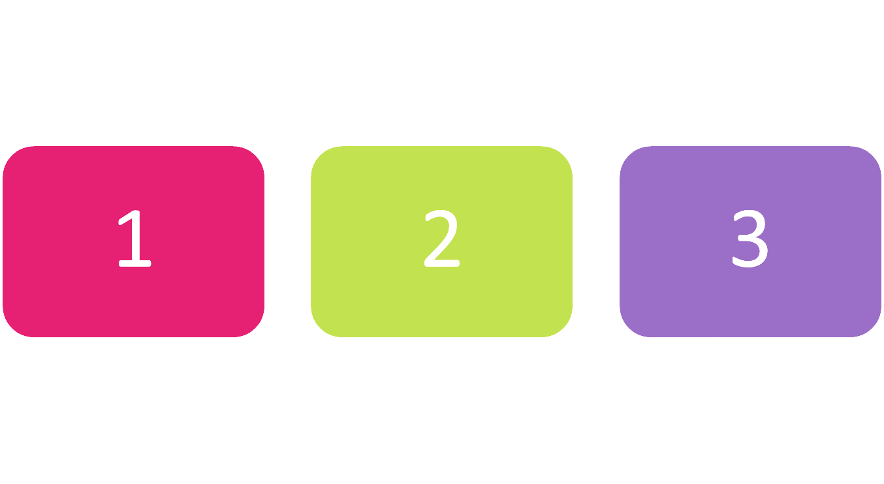
Enumerations
Syntax and Usage

Slide 24
Enumerations
Represent a numeric value from a fixed set as a text
We can use them to pass arguments to methods without making code confusing
By default enums start at 0
Every next value is incremented by 1
enum Day { Mon, Tue, Wed, Thu, Fri, Sat, Sun }
GetDailySchedule(0)
GetDailySchedule(Day.Mon)

Slide 25




Enumerations (2)
We can customize enum values
enum Day
{
Mon = 1,
Tue, //2
Wed, //3
Thu, //4
Fri, //5
Sat, //6
Sun //7
}
enum CoffeeSize
{
Small = 100,
Normal = 150,
Double = 300
}

Slide 26

Problem: Hotel Reservation
Create a class PriceCalculator that calculates the total price of a holiday, by given price per day, number of days, the season and a discount type
The discount type and season should be enums
The price multipliers will be:
1x for Autumn, 2x for Spring, etc.
The discount types will be:
None – 0%
SecondVisit – 10%
VIP – 20%
Check your solution here: https://judge.softuni.bg/Contests/1495/Working-with-Abstraction-Lab

Slide 27
Solution: Hotel Reservation
public enum Season
{
Spring = 2,
Summer = 4,
Autumn = 1,
Winter = 3
}
public enum Discount
{
None,
SecondVisit = 10,
VIP = 20
}
Check your solution here: https://judge.softuni.bg/Contests/1495/Working-with-Abstraction-Lab

Slide 28
Solution: Hotel Reservation (2)
public class PriceCalculator {
public static decimal CalculatePrice(decimal pricePerDay, int numberOfDays, Season season, Discount discount) {
int multiplier = (int)season;
decimal discountMultiplier = (decimal)discount / 100;
decimal priceBeforeDiscount = numberOfDays * pricePerDay * multiplier;
decimal discountedAmount =
priceBeforeDiscount * discountMultiplier;
decimal finalPrice = priceBeforeDiscount - discountedAmount;
return finalPrice; }
}
Check your solution here: https://judge.softuni.bg/Contests/1495/Working-with-Abstraction-Lab

Slide 29

Static Classes
Static Class Members

Slide 30
Static Class
A static class is declared by the static keyword
It cannot be instantiated
You cannot declare variables from its type
You access its members by using the its name
double roundedNumber = Math.Round(num);
int absoluteValue = Math.Abs(num);
int pi = Math.PI;

Slide 31
Static Members
Both static and non-static classes can contain static members:
Methods, fields, properties, etc.
A static member is callable on a class even when no instance of the class has been created
Аccessed by the class' name, not the instance name
Only one copy of a static member exists, regardless of how many instances of the class are created

Slide 32
Static Members (2)
Static methods can be overloaded but not overridden
A const field is essentially static in its behavior and it belongs to the type, not the instance
Static members are initialized before the static member is accessed for the first time and before the static constructor
Bus.Drive();
int wheels = Human.NumberOfWheels;

Slide 33
Example: Static Members
public class Engine
{
public static void Run()
{
Console.WriteLine("This is a static method");
}
}
public static void Main()
{
Engine.Run();
}
// Output: This is a static method

Slide 34

Namespaces
Definition and Usage

Slide 35
Namespaces
Used to organize classes
The using keyword allows us not to write their names
Declaring your own namespaces can help you control the scope of class and method names
System.Console.WriteLine("Hello world!");
var list = new
System.Collections.Generic.List<int>();

Slide 36

Summary
…
…
…
Well organized code is easier to work with
We can reduce complexity using Methods, Classes and Projects
Enumerations define a fixed set of constants
Static classes cannot be instantiated
Namespaces organize classes

Slide 37












SoftUni Diamond Partners

Slide 38



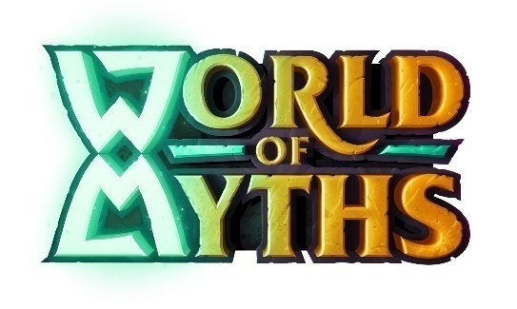
SoftUni Organizational Partners

Slide 39




Trainings @ Software University (SoftUni)
Software University – High-Quality Education and Employment Opportunities
softuni.bg
Software University Foundation
http://softuni.foundation/
Software University @ Facebook
facebook.com/SoftwareUniversity
Software University Forums
forum.softuni.bg

Slide 40

License
This course (slides, examples, demos, videos, homework, etc.) is licensed under the "Creative Commons Attribution-NonCommercial-ShareAlike 4.0 International" license

